Slide 1

CSE 6363: Project Review 1
<Mihir Ingole, Eldho Joy, Dannasri Srinivasan>

Slide 2
Classification of Autism Spectrum disorder using computer vision with deep learning and the ABIDE dataset
WHO: ASD affects one child in 160 worldwide CDC : ASD affects one in 68 children in the United States
Identification of Autism Spectrum Disorder
Diagnosing neurological diseases requires a model based on functional or structural region relationships in the brain
Functional magnetic resonance imaging (fMRI) is used to study the brain and its structures
Autism brain imaging data exchange (ABIDE) involving neuroimaging and phenotypic data obtained from 1,112 individuals with 539 ASD patients and 573 others, from 17 sites

Slide 3
Existing Research
Automated Detection of Autism Spectrum Disorder Using a Convolutional Neural Network [Zeinab Sherkatghanad, Mohammadsadegh Akhondzadeh, Soorena Salari, Mariam Zomorodi-Moghadam, Moloud Abdar, U. Rajendra Acharya, Reza Khosrowabadi and Vahid Salari.]
Identification of autism spectrum disorder using deep learning and the ABIDE dataset [Anibal Sólon Heinsfeld, Alexandre Rosa Franco R. Cameron Craddock, Augusto Buchweitz, Felipe Meneguzzi]
Multisite functional connectivity MRI classification of autism : ABIDE results [JaredA.Nielsen, Brandon A. Zielinski, P. Thomas Fletcher, Andrew L. Alexander, NicholasLange, ErinD.Bigler, Janet E. Lainhart and Jeffrey S. Anderson]

Slide 4
ABIDE dataset
ABIDE I is a consortium of collected resting-state fMRIs from 17 international imaging sites and matched controls that is provided for scientific research
Each site in the ABIDE I dataset uses different parameters and protocols.
fMRI is based on neural measurements of functional connectivity between multiple brain regions.
These datasets contain T1 structural brain images, fMRI images, and phenotypic information relating to different patients.
The phenotypic information is classified based on sex, age, and autism diagnostic observation schedule (ADOS) score for ASD subjects and mean framewise displacement (FD) quality.

Slide 5
ABIDE dataset
Caltech_0051456_reho

Slide 6
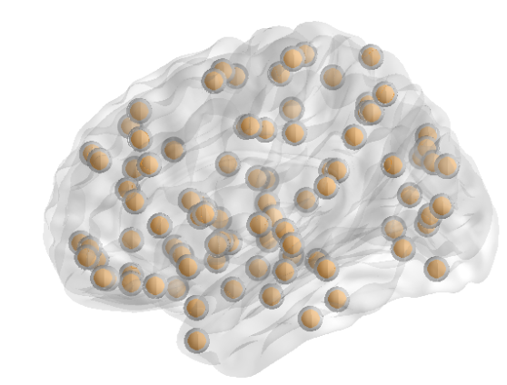
Data Pre-Processing
Preprocessed Connectomes Project (PCP) is a publicly available preprocessed version of data
We’ll be using data using the configurable pipeline, the Analysis of Connectomes (CPAC).
The preprocessing step includes slice timing correction, correction for motion, and normalization of voxel intensity
Nuisance regression to delete the signal fluctuations caused by head motion, respiration, cardiac pulsation, and scanner drift
CC400 functional parcellation atlas
AAL90 (automated anatomical labeling)

Slide 7
Timeline
Task | Expected Completion Time
Finalizing Project Presentation | 9th Sept 2022
Data Collection | 24th Sept 2022
Data Pre-processing | 30th Sept 2022
Model Creation | 8th Oct 2022
Model Training | 15th Oct 2022
Testing and Validation | 22nd Oct 2022
Documentation | 29th Oct 2022

Slide 8
Network Architecture

Slide 9
Summary of comparison table for automated detection of TC and ASD classes using the same database.
References | Method | Specificity | Sensitivity | Accuracy
Nielsen et al. (2013) | Multiple bins and leave- one-out classifier | 58.00 | 62.00 | 60.00
Heinsfeld et al. (2018) | Deep Neural Networks (DNN) and transfer learning | 63.00 | 74.00 | 70.00
Zeinab Sherkatghanad et al. (2019) | CNN | 61.00 | 77.00 | 70.20

Slide 10
Thank You!

